Slide 1
IBM University Engagement Project Submission
“Exploring the Power of Agentic AI with IBM Granite and LangFlow”

Slide 2

Project Tile – Agentic AI for Mental Health Awareness & Suicide Prevention
Domain of Project – Healthcare & Mental Wellness
Student Name | Recent Passport Photo | Email ID | Mobile number [WhatsApp]
Hamsaveni R |  | hamsavenir894@gmail.com | 9148483351

Slide 3
Problem Statement -
Mental health disorders such as depression, anxiety, stress, and suicidal ideation are increasing rapidly across the world, especially among students and young adults. Due to social stigma, lack of awareness, limited access to mental health professionals, and delayed intervention, many individuals struggle silently without receiving timely emotional support or guidance. Existing mental health systems are often reactive rather than preventive, making it difficult to identify early warning signs before a crisis occurs.
There is a need for an intelligent, empathetic, and proactive solution that can promote mental health awareness, provide emotional support, detect distress signals at an early stage, and connect individuals with appropriate human assistance when necessary.
The challenge is to design and develop an Agentic AI-powered Mental Health Awareness & Suicide Prevention System using LangFlow, IBM watsonx.ai, and IBM Granite Models. The system should leverage Retrieval-Augmented Generation (RAG) and multi-agent workflows to analyze conversations, journaling inputs, or behavioral patterns in order to identify signs of emotional distress, stress, depression, or suicidal tendencies.
The proposed solution must:

Slide 4
Promote mental health awareness and self-care practices Provide empathetic and safe conversational support Detect early warning signs using AI-driven analysis Predict potential mental health risks proactively Recommend coping strategies and preventive actions Escalate high-risk situations to counselors, helplines, or trusted contacts with user consent Ensure ethical AI practices, privacy, transparency, and human-in-the-loop safety mechanisms The goal is to create a scalable, trustworthy, and socially impactful AI assistant that supports mental well-being and contributes toward suicide prevention through timely intervention and accessible mental health support.

Slide 5
Technology Used
LangFlow + IBM watsonx.ai + Granite Models
Technologies Used:
LangFlow – Agentic AI workflow orchestration
IBM watsonx.ai – AI model hosting and deployment
IBM Granite Models – Conversational AI, sentiment analysis, and empathetic response generation
Python – Backend development
FastAPI – API integration and communication
MongoDB – Data and chat history storage
FAISS / ChromaDB – Vector database for RAG implementation
React.js – Frontend user interface
Docker & IBM Cloud – Deployment and scalability

Slide 6
Proposed Solution -
The proposed solution for an Agentic AI system for mental health awareness and suicide prevention is a multi-agent intelligent framework designed to continuously detect emotional distress, provide empathetic support, and ensure timely intervention in crisis situations. The system operates through a coordinated set of specialized AI agents. An Emotion Detection Agent analyzes user inputs such as text or voice to identify emotional states like stress, anxiety, or hopelessness using natural language processing and behavioral signals. A Risk Assessment Agent evaluates the severity of distress and determines the likelihood of self-harm or suicidal ideation based on contextual understanding rather than simple keyword detection. If distress is identified, a Conversational Support Agent engages the user in a compassionate, non-judgmental dialogue, offering emotional reassurance and evidence-based coping strategies such as grounding techniques or cognitive behavioral therapy-inspired reframing. In parallel, an Awareness and Education Agent provides personalized mental health resources, wellness tips, and preventive guidance to improve long-term emotional resilience. When high-risk conditions are detected, a Crisis Escalation Agent immediately activates, encouraging the user to contact mental health helplines, reach trusted contacts, or connect with emergency services, while also alerting trained human

Slide 7
professionals through a Human-in-the-Loop system for real-time intervention. The entire system is designed with strict ethical safeguards, ensuring privacy protection, avoiding diagnostic labeling, minimizing dependency on AI, and maintaining human oversight for critical decisions. Deployed through mobile applications, messaging platforms, and institutional systems, this Agentic AI framework aims to provide early detection of mental health issues, reduce barriers to seeking help, and create a scalable digital safety net that supports individuals while complementing professional mental health services.

Slide 8
Langflow component Used -
Chat Input – Interface where users enter their emotional state, concerns, or queries (text/voice). It captures conversation signals like stress, anxiety, or distress for further processing.
IBM watsonx AI Agent – Processes user input using Granite models to generate empathetic, safe, and context-aware mental health responses, emotional support, and guidance.
Name of IBM Granite model – Granite-4.0-8B-Instruct → Efficient for real-time empathetic conversation, emotional understanding, and safe response generation in mental health scenarios.
Chat Output – Displays AI-generated responses such as emotional support messages, coping strategies, awareness suggestions, and crisis guidance (e.g., helpline recommendations when needed).
File Component – Stores and retrieves user conversation history, emotional trends, risk flags, and interaction logs to help track long-term mental well-being patterns (with privacy safeguards).
Emotion & Suicide Risk Analysis Component (Custom Python / ML Node) – Analyzes user text to detect emotional states (stress, sadness, hopelessness) and assigns a suicide risk level (low/moderate/high). This component helps trigger safe escalation when necessary.

Slide 9
Guardrails & Safety Component – Ensures the system provides non-judgmental, non-diagnostic, and safe responses. It blocks harmful outputs, enforces empathetic tone, and ensures escalation protocols are followed in crisis situations.

Slide 10
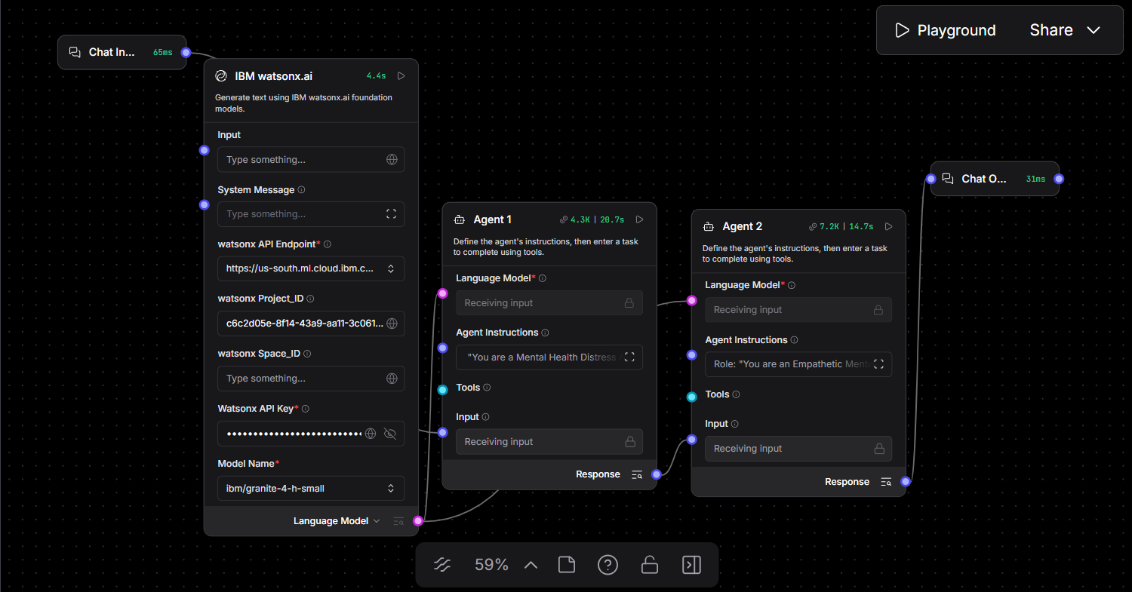
Langflow workflow -

Slide 11
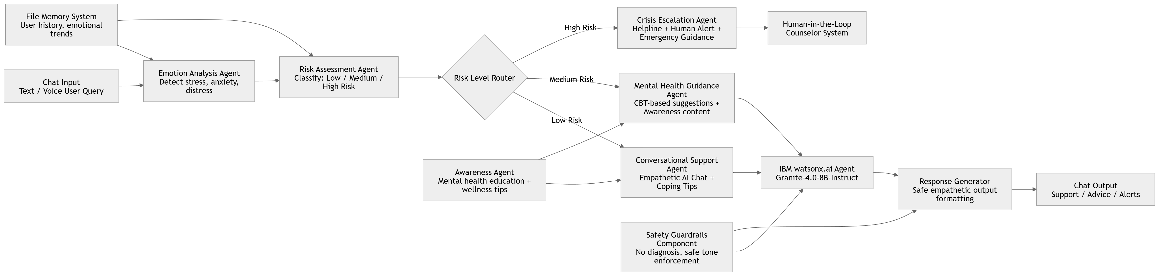
Architecture blueprint

Slide 12
Role of Agentic AI in Mental Health Awareness & Suicide Prevention
Role of Agentic AI in Mental Health Awareness & Suicide Prevention
Agentic AI enables the Mental Health Support System to function as an intelligent, autonomous, and safety-driven digital companion rather than a simple conversational chatbot. Using platforms like IBM watsonx.ai and IBM Granite models, it coordinates multiple specialized agents that work together to detect emotional distress, provide empathetic support, and ensure timely crisis intervention.
Each agent performs a specific role—such as analyzing emotional tone, assessing suicide risk levels, generating empathetic responses, providing coping strategies, and connecting users to mental health resources—while collaborating in real time. This multi-agent approach ensures accurate understanding of user emotions and appropriate response generation in sensitive situations.
Agentic AI also brings deep context awareness, allowing the system to understand user behavior patterns, emotional history, and situational factors such as loneliness, stress, or traumatic events. Based on this context, it generates personalized mental health guidance and adapts responses dynamically as the user’s emotional state changes over time.

Slide 13
In addition, the agents continuously communicate with each other. For example, if the Emotion Analysis Agent detects severe distress, it immediately informs the Risk Assessment Agent and Crisis Escalation Agent to trigger urgent safety protocols, such as suggesting helplines or alerting human counselors. Overall, Agentic AI makes the system proactive, empathetic, and safety-oriented, acting like a responsible digital mental health assistant that not only supports users emotionally but also helps prevent suicide risks through early detection, continuous monitoring, and timely intervention.

Slide 14
Technology Used
Langflow Platform – For designing and orchestrating multi-agent workflows visually. It helps in building a structured flow between Emotion Detection Agent, Risk Assessment Agent, Conversational Support Agent, and Crisis Escalation Agent.
IBM Granite Model – e.g., ibm-granite-4.0-8b-instruct – Used for natural language understanding, empathetic reasoning, and generating personalized, safe, and supportive mental health responses.
IBM Cloud – Provides the infrastructure to build, deploy, and scale the Mental Health Agent system efficiently. It ensures a secure, reliable, and scalable environment for hosting AI services, APIs, and real-time alert systems.
RAG (Retrieval-Augmented Generation) – Used to fetch verified mental health knowledge first (such as WHO guidelines, therapy techniques, and crisis helplines) and then generate accurate and safe responses, making the system more trustworthy and context-aware.
IBM watsonx.ai – Used for model deployment, prompt engineering, embeddings, and AI governance. It ensures safe AI behavior, monitoring, and compliance with ethical AI standards in mental health applications.
.

Slide 15
Vector Database (FAISS / ChromaDB) – Used for storing and retrieving mental health knowledge, past user emotional history, and coping strategies. It supports RAG-based retrieval for generating personalized and context-aware responses.

Slide 16
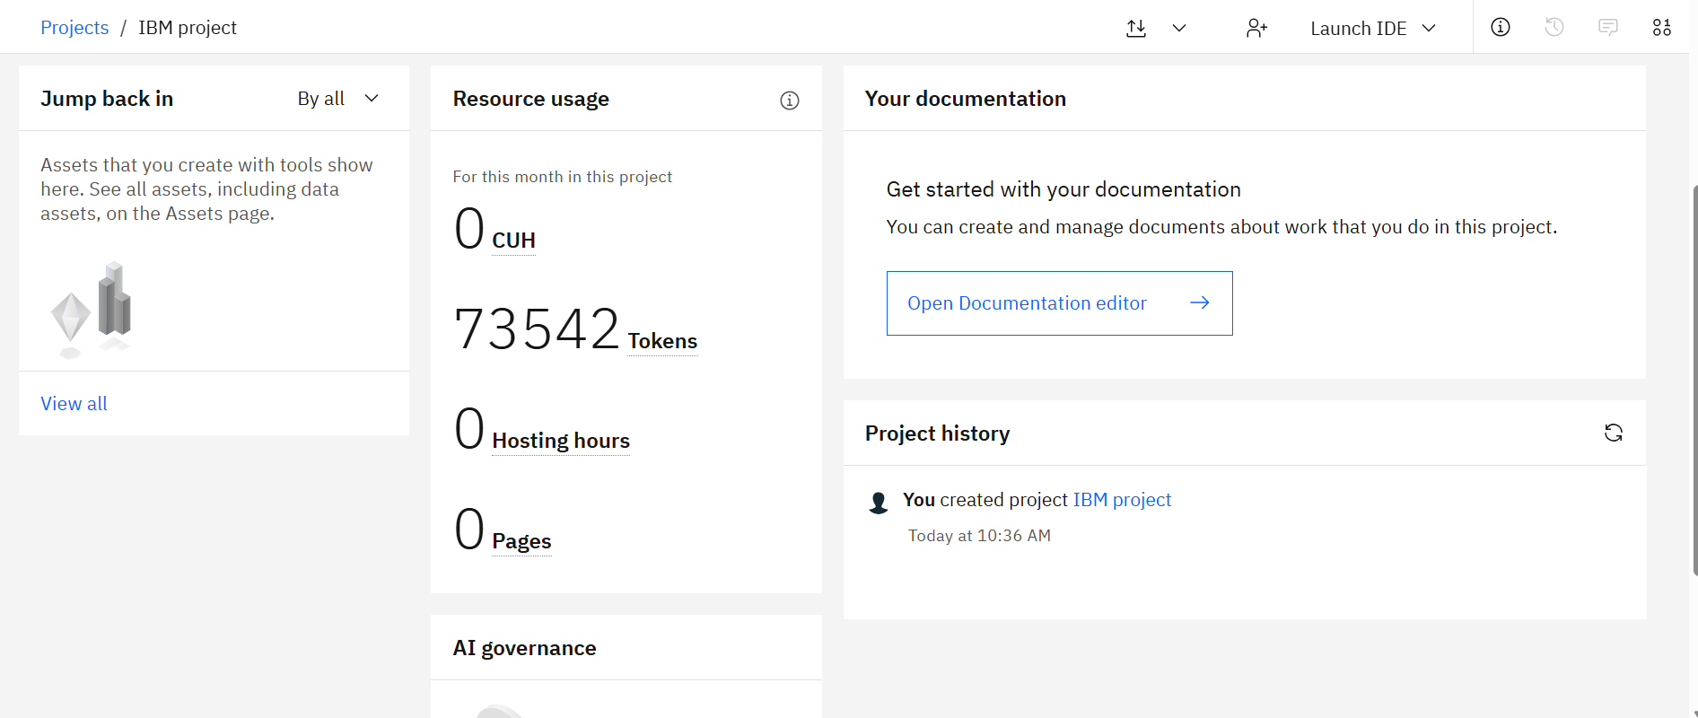
Token Usage
73542 token are used
·
·
·

Slide 17
Novelty and Uniqueness
The proposed system is unique because it goes beyond a traditional chatbot and introduces a multi-agent, safety-driven, and proactive mental health support ecosystem powered by Agentic AI. Unlike existing mental health apps that provide static responses or simple conversational support, this system dynamically understands emotions, assesses risk levels, and takes appropriate action in real time.
A key novelty is the use of a multi-agent architecture, where specialized agents independently handle emotion detection, risk analysis, conversational support, awareness generation, and crisis escalation. These agents collaborate intelligently to ensure that responses are not only empathetic but also context-aware and safety-focused.
Another unique aspect is the integration of real-time suicide risk detection with escalation mechanisms, ensuring that high-risk users are immediately guided toward professional help, helplines, or human counselors. This makes the system proactive rather than reactive.
The use of IBM Granite models within watsonx.ai enhances the system’s ability to generate human-like, emotionally sensitive, and personalized responses while maintaining strict safety guardrails to avoid harmful or misleading outputs.
Additionally, the incorporation of RAG (Retrieval-Augmented Generation) ensures that all responses are grounded in verified mental health knowledge such as WHO guidelines and therapy-based coping strategies, improving trust and reliability.

Slide 18
The system also maintains long-term emotional context awareness using vector databases, allowing it to track user emotional patterns over time and provide personalized interventions rather than isolated responses. Finally, the inclusion of AI safety guardrails, human-in-the-loop escalation, and ethical constraints makes the system highly responsible, ensuring that it supports users without replacing professional mental health care. Overall, the novelty lies in combining Agentic AI + mental health safety + real-time risk intervention + grounded knowledge retrieval into a single intelligent, ethical, and scalable support system.

Slide 19
Git Hub Link
https://github.com/hamsavenir894-hash/MentalHealth-Agent
·
·
·

Slide 20
Future Scope
1. Integration with Wearables & Digital Health Signals
The system can be extended by integrating with smartwatches, fitness trackers, and mobile health sensors to collect real-time behavioral indicators such as sleep patterns, heart rate variability, physical activity levels, and stress signals. These physiological insights can help the Agentic AI system detect early warning signs of emotional distress more accurately. By combining biometric data with conversational inputs, the system can provide more proactive and timely mental health interventions, enabling early detection of anxiety, depression, or crisis states.
2. AI-Powered Voice Assistant & Multilingual Support
The system can be enhanced with a voice-enabled AI assistant that allows users to express their emotions naturally through speech instead of text. This improves accessibility, especially during emotional distress when typing may be difficult. Additionally, integrating multilingual support enables users to interact in their native language, making the system more inclusive and culturally sensitive. This is particularly important for diverse populations, ensuring that mental health support is accessible across different regions, languages, and literacy levels.
.
·
·
·

Slide 21


